Slide 1

carbmee - carbon platform solution
Supplier CBAM training
2024/25
© carbmee, 2024. All rights reserved.

Slide 2


AGENDA
Introduction carbmee
Overview CBAM
Collaboration for CBAM
Data collection
Q&A
© carbmee, 2024. All rights reserved.

Slide 3
Disclaimer
All data is handled with utmost care and is save. If you have any questions about IT security, carbmee will be pleased to provide you with all details.
This document is not legally binding; the EU regulations must be taken into account for legally binding information. The regulation is published by the EU commission.
Attached to this document you can find a CBAM glossary including technical terms and detailed explanations.

Slide 4
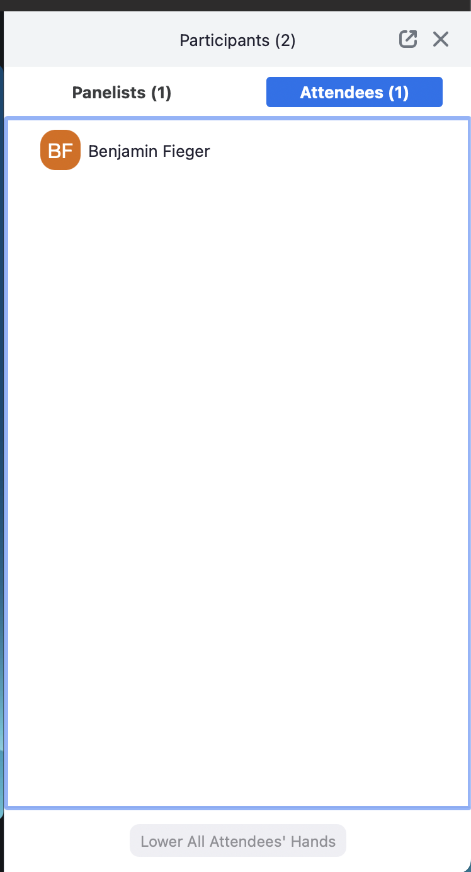
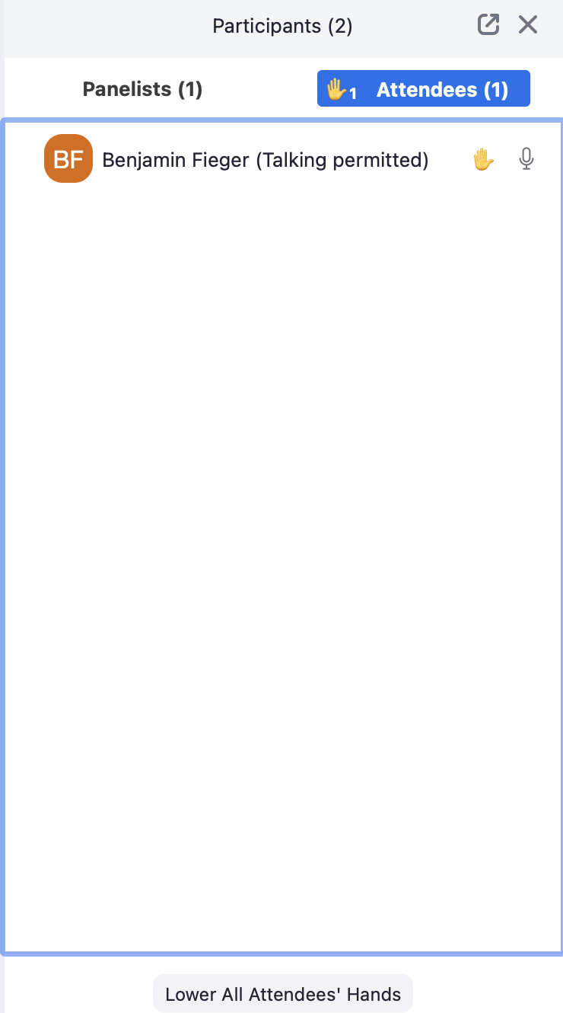

How-to guide for Zoom

Slide 5


Your trusted team at carbmee
Meet your team
Florian Renneberg | Sustainability and CBAM Expert at carbmee. Florian a in-house expertise specialist, is here to provide you with updates and guidance everything to do with CBAM.
Leona Mrackova | Supplier Engagement Manager your primary point of contact and responsible for delivery of supplier support and engagement throughout the project.

Slide 6

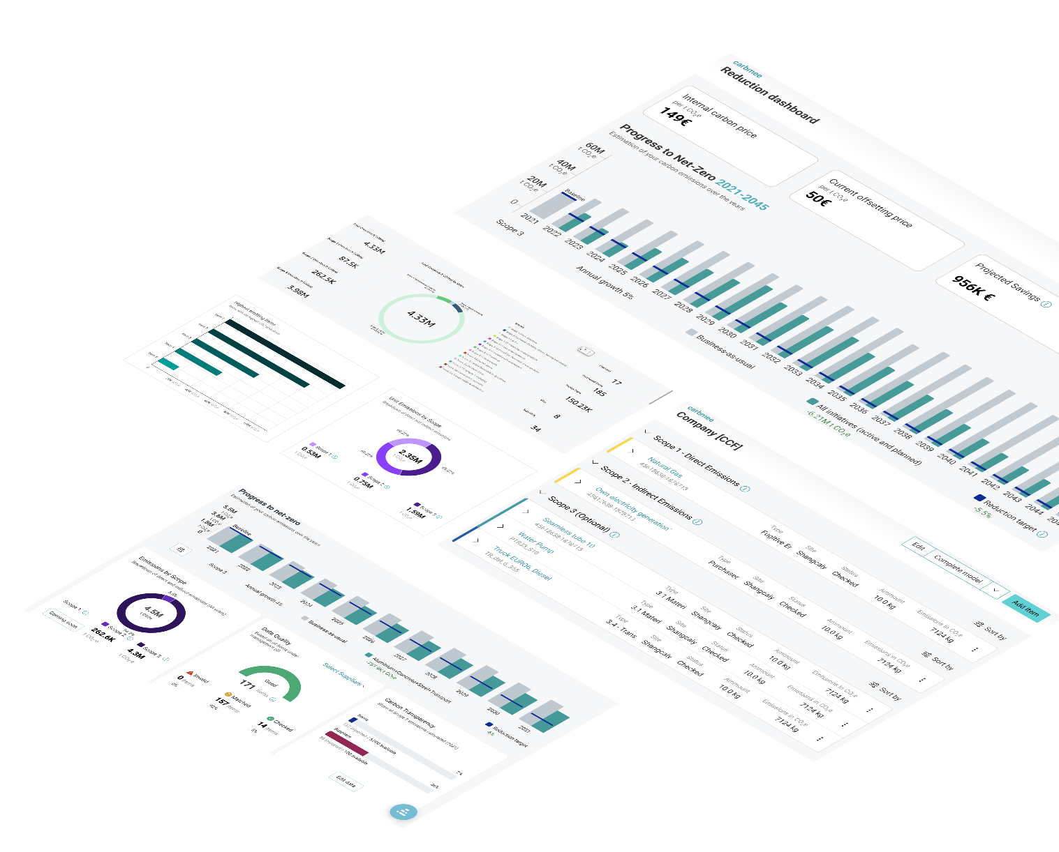














carbmee EIS™: Carbon management platform to empower enterprises with carbon reduction
Measure, manage and reduce carbon emissions in complex
supply chains on transactional & SKU level (indirect & direct)
Creating scalable & verified Carbon Footprints (Product, Supplier,
Corporate)
Decarbonizing & reaching your SBTi-targets
Reporting environmental data for CBAM, CSRD, SEC, TCFD, CDP
Gartner Hype Cycle Sustainability 2023 for
Scope 3 GHG Emissions &
Carbon Management

Slide 7
CBAM
Overview
© carbmee, 2024. All rights reserved.

Slide 8
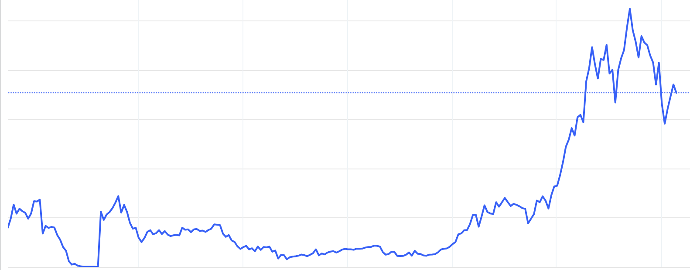
Overview CBAM
Carbon Border Adjust Mechanism (CBAM):
Aims to prevent carbon leakage and ensure a level playing field for EU industries by imposing equal carbon costs on imported goods.
What does it mean for your customer?
As certain your customer imports fall into the scopes of CBAM goods, your customer must report on them quarterly.
What does it mean for you, as a supplier?
For your customer to fulfill its obligations under the CBAM regulation, cooperation from suppliers is required.
EU Emission Trading System price (EUR/tCO2e) since 2005, the carbon price is expected to rise to up to 200 (EUR/tCO2e).
For imposing equal carbon costs EU-imports will have the same carbon price as goods under the EU-ETS (till 2034)
100€
80€
60€
40€
20€
Year
2008
2011
2014
2017
2020
2023
2024
© carbmee, 2024. All rights reserved.

Slide 9
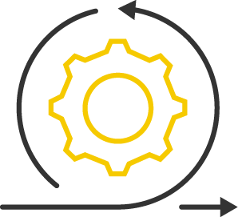



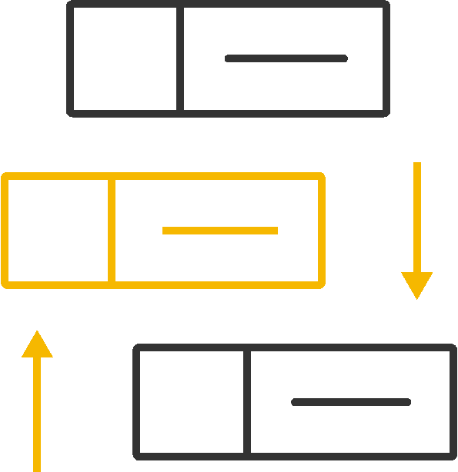

Overview CBAM
Carbon Border Adjust Mechanism (CBAM):
Aims to prevent carbon leakage and ensure a level playing field for EU industries by imposing equal carbon costs on imported goods.
What does it mean for your customer?
As certain your customer imports fall into the scopes of CBAM goods, your customer must report on them quarterly.
What does it mean for you, as a supplier?
For your customer to fulfill its obligations under the CBAM regulation, cooperation from suppliers is required.
Iron and Steel
Aluminium
Fertilizers
Electricity
Cement
Hydrogen
Sectors covered in CBAM: for more details, find EU resources
Based on the Custom Combined Nomenclature (CN) codes that your customer specifies for customs clearance, we determine whether the import of the commodity is considered CBAM relevant. A list of all CN Codes can be found on the EU CBAM website
Shipment information from the customs clearance process, like CN Code or weights, may differ from the information you have as a supplier
© carbmee, 2024. All rights reserved.

Slide 10
CBAM timeline
Timelines: for more details find EU resources here
Q4/2023: Quarterly report on transactional level for all relevant CN Codes
Q3/2024: Quarterly report on transactional level without default values - PRIMARY DATA FROM EVERY SUPPLIER REQUIRED
2026: + starting phase out of the free allowance for the EU-ETS and phase in of the CBAM costs - financial impact of legislation kicks in
2034:+ full phase out of free allowance for the EU-ETS and full phase in of the CBAM costs
Long-term
From 2026 onwards your customer will have to purchase CBAM certificates for the import of CBAM goods

Slide 11

Overview CBAM
CBAM mechanism: for more details find EU resources here
Market outside of the EU
EU domestic market
Imports
your customer,
CBAM Declaranet
CBAM Authority
The declaration of CBAM goods is forwarded
Continuous purchase of CBAM certificates
Annual submission of CBAM declaration and required CBAM certificates
Requests
Production of CBAM goods in a third country.
“Generally all non-EU countries with a few exception, reference to the EU resources.”
With verified monitoring of direct and indirect Emissions and documentation of the CO2 price paid
Data for verified Emissions Report for CBAM declaration
Sale and repurchase of CBAM certificates
Control of CBAM decorations
Imposing penalties
Pricing of CBAM certificates
via average calender week price of the EU-ETS certificates
Supplier’s primary data is compulsory by Q3’24 (EU Commission)
EU-ETS Market
Sales
EU-ETS Auctions
Sales
Purchase
ETS production
With approved monitoring concept or the surveillance of their annual missions and reporting
Supplier
Graph source: FfE Munich
Graph source: FfE Munich

Slide 12
COLLABORATION
For CBAM
© carbmee, 2024. All rights reserved.

Slide 13

How does the collaboration work?
General CBAM information:
On May 17, 2023, the European Union implemented the Carbon Border Adjustment Mechanism (“CBAM”)
Within the Transitional Period (Q4/2023 – Q4/2025): Mandatory reporting of quantity of goods imported into the EU and their embedded GHG emissions (quarterly) is required for importers
Starting from Q3/2024 primary data from suppliers is legally required, thus your customer asks for your collaboration
Your CBAM customer
For your customer to fulfill its obligations under the CBAM regulation, cooperation from partners is essential. your customer decided to conduct the CBAM data collection with the help of carbmee.
Training sessions
including this one, are led by carbmee. information about all events will be sent by carbmee. Materials & guidelines will be shared by carbmee.
We are your trusted CBAM and sustainability experts. Feel free to contact us throughout the engagement process for any questions or support.
For any technical help or support using the platform, please contact carbmee directly. We are here to help.

Slide 14
Collaboration going forward
01
During this project both your customer and carbmee will be in regular communication with you
Few examples might be, invitation to a training webinar, distribution of training materials, timeline updates and 1:1 meetings if needed
We will need timely responses from your team to ensure effective communication and to keep the timeline
Communication
02
For your customer to fulfill its obligations under the CBAM regulation, cooperation from your company is essential
You are expected to provide all awaited data concerning the relevant products in a comprehensive and timely manner. The carbmee team will be able to provide you with any needed support during data collection
Please note that you are fully accountable for the accuracy of the provided data. Should incorrect data be supplied, your customer reserves all its rights regarding further actions to be engaged in terms of liability and relationships
Data availability
03
Within this training you will learn how to provide data to carbmee in the correct manner, nevertheless you always have the choice to follow the EU approach of data collection
If you have all relevant CBAM data for your customer available in the EU CBAM template you can forward it directly to suppliersupport@carbmee.com or upload to carbmee’s EISTM
Carbmee will check the completeness of the data and come back to you if necessary
Data upload

Slide 15
DATA
Data collection & preparation
© carbmee, 2024. All rights reserved.

Slide 16
Your CBAM journey with your customer & carbmee
Timelines: for more details find EU resources here
Oct W1 24
First Supplier training webinar & distribution of first CBAM training materials
Oct W1 24
1:1 Supplier Training & distribution of relevant training materials
Oct W 1-3 24
Data collection for CBAM (details in CBAM training materials & 1:1 Supplier Training)
Oct W 3-4 24
Data verification together with carbmee team
October 24
Q3/2024 CBAM report submission by your customer with primary data
Ongoing
Regular updates & iterations for upcoming quarters
Short-term
Based on your availability
Based on your progress
Involvement for you as a supplier

Slide 17
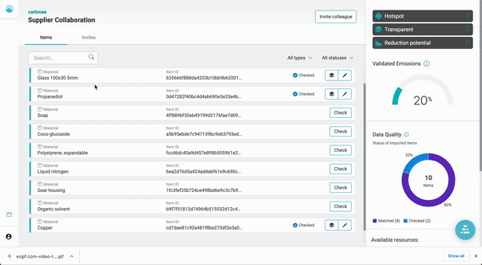
How carbmee supports your data collection
1. Set-up your account
After the 1:1 training you’ll receive an email inviting you to join the EISTM .
Please set-up your login and password protection.
Remark: If you have the EU CBAM template available, you can upload it to carbmee EISTM or send it to suppliersupport@carbmee.com
2. Check pre-calculated emissions
carbmee has already pre-calculated your CBAM emissions based on the information shared by the your customer, this precalculation will be handed out in EISTM & in an Excel sheet
3. Collect & edit data
After collecting your data you can adjust carbmee’s data & carbmee will update the in data in EISTM
4. You are done!
carbmee will validate your data and come back to you if anything is incomplete or incorrect. You can ask for support any time

Slide 18
CBAM data workflow
This graph is showing the data workflow between your customer, carbmee & you as CBAM supplier
your customer shares CBAM
relevant import data with carbmee by uploading it
to carbmee EISTM
carbmee enriches the data for the supplier onboarding. You receive access to supplier relevant data
Within the training sessions you learn how to work with CBAM data. You can either use carbmee approach or use the EU CBAM template
After collecting or enriching your data, carbmee automatically updates the data in carbmee EISTM for your customer
After finalising the data collection carbmee prepares the CBAM reports for your customer

Slide 19
Overview Data Requirements
Based on the workflow described on the previous page, Carbmee receives data from your customer (as shown on the left side of the slide) and collaborates with you as a supplier to collect and calculate the data presented on the right side of the slide.
Input your customer
Data collection supplier
Direct Embedded Emissions
Indirect Embedded Emissions
Precursors
Production Methods
Other qualifying parameters
Carbon Price
MATERIALS
Material Number
CN Code
Quantity Imported
For each Material sold to your customer
Installation Information

Slide 20
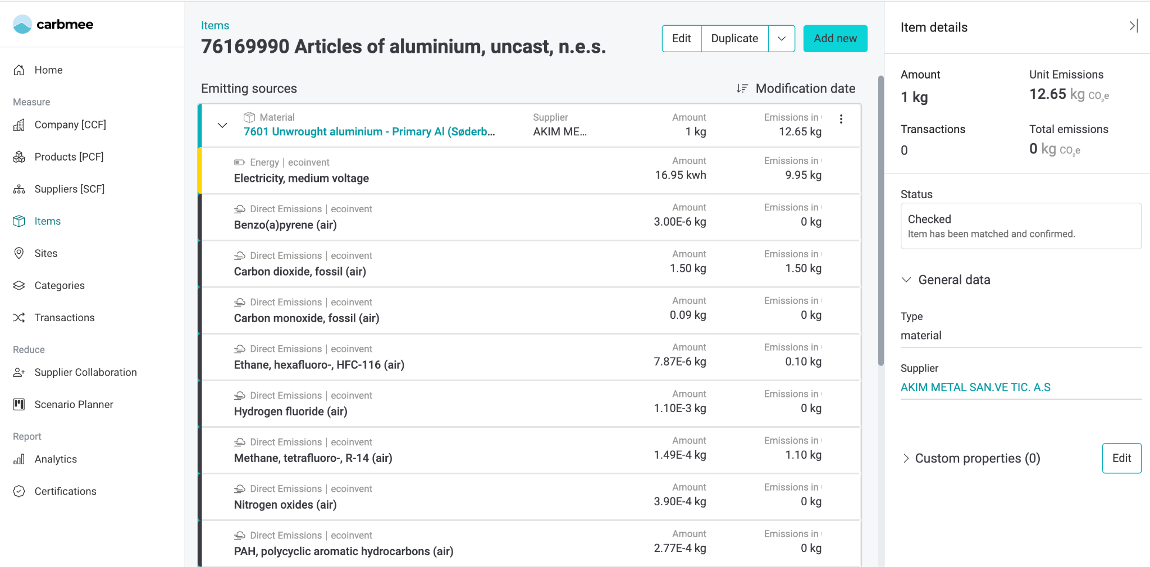
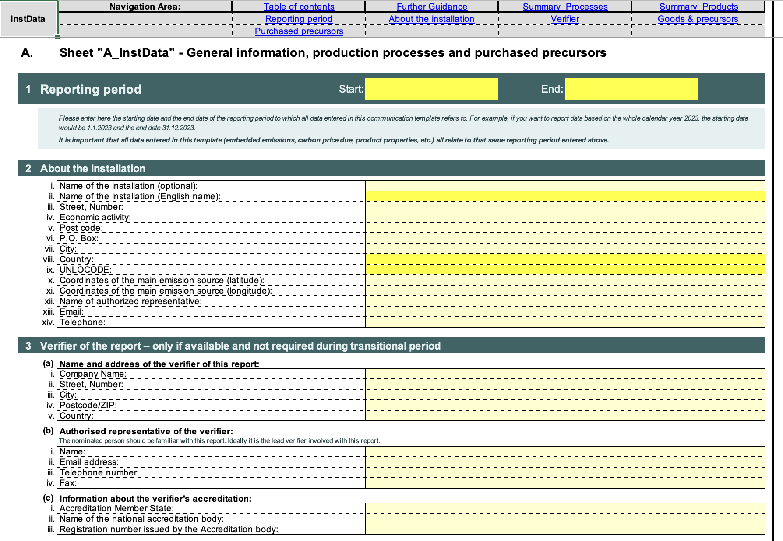
Data collection: carbmee vs. EU approach
You as a supplier you have two options for uploading your data and collaborating with us. Both outlined options are free of charge for you, relevant materials & trainings are available and the calculations can be used for other customers of yours.
01
02
Carbmee approach
EU approach
You as a supplier can use EISTM CBAM models for reporting
If you have the EU Excel sheet prefilled, you can directly upload it to EISTM

Slide 21
CBAM emissions during the transitional phase
Within this graph the CBAM scope is shown, for more details find EU resources here
In CBAM scope
Scope 2
Indirect
Scope 3
Indirect
Not in CBAM scope
Electricity consumed for the production of CBAM goods
Use phase, transportation, distribution and end of life
Scope 3
Indirect
Scope 1
Direct
I
Emissions generated from the production of CBAM goods
Raw materials
Input materials under CBAM
Upstream
Company Production
Downstream

Slide 22
Steps to determine specific embedded emissions
Step 1. Define the system boundaries associated with the production processes
Step 2. Identify relevant parameters and methods, then carry out monitoring
Step 3. Attribute emissions to production processes and then to goods
Step 4. Add the specific embedded emissions of relevant precursors

Slide 23
Step 1: System boundaries
CBAM targets the embedded carbon emissions of products imported into the EU for the sectors cement, iron and steel, aluminium, fertilizers, hydrogen and electricity.
This includes some of the precursors* in the production process. A list of all affected materials can be found here
The affected emissions are:
Direct emissions: include combustion and process emissions for your installation, but also emissions produced during the production of heat consumed in your installation, in case the installation receives heat from adjacent installations or from a district heating network.
Indirect emissions: include emissions related to the electricity consumed at your installation.
Only upstream emissions are included.
Direct emissions
combustion, production emissions, PFCs, heat
Indirect emissions
purchased electricity
* Precursors refer to materials or products that are intermediate goods used in the production of other goods that are subject to the CBAM (more details on the following slides)

Slide 24
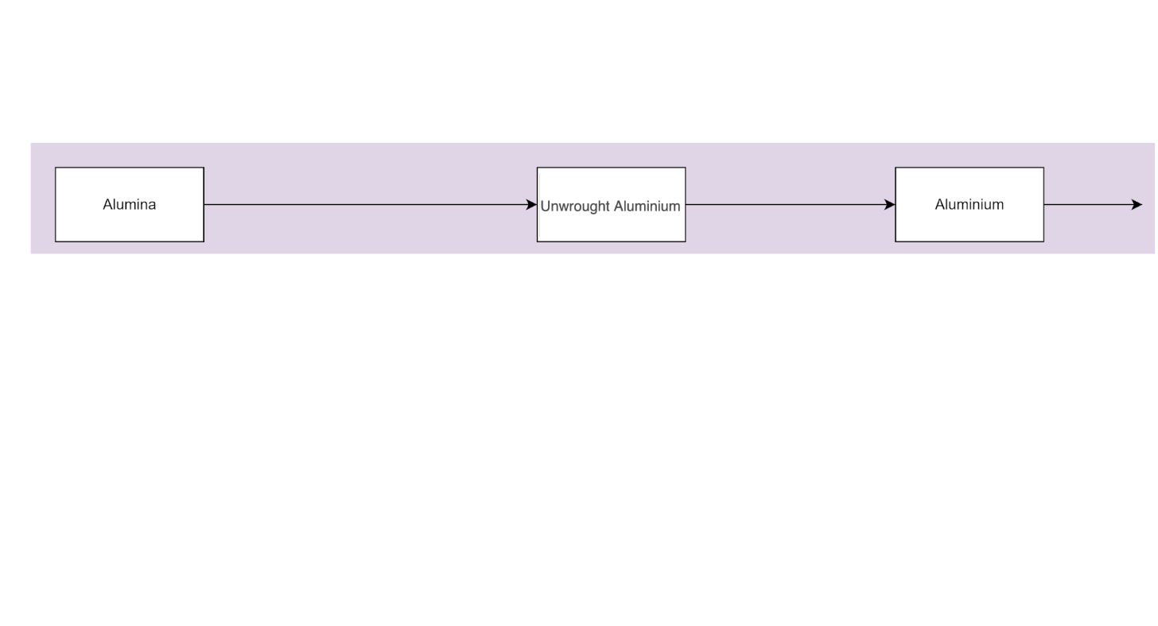
Step 1: System boundaries
Aluminium Example
Let’s examine the case of aluminum being imported into the EU. Aluminum is made from unwrought aluminum, which is produced from alumina. This diagram represents a very simplified material flow of the different product stages.
Notes:
Completed
Check sentence
Check 24

Slide 25
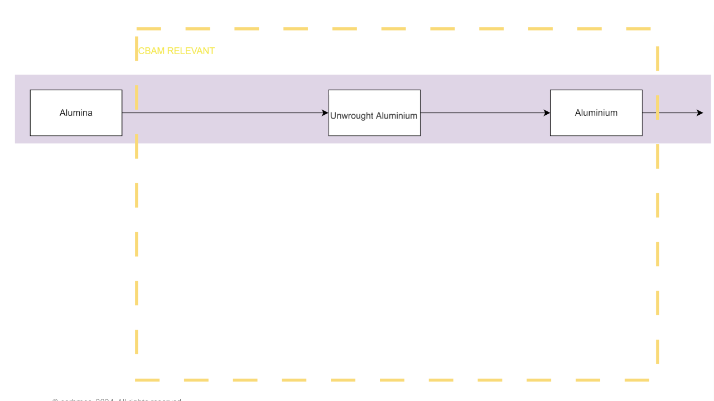
Step 1: System boundaries
Not all products or unfinished products are affected by CBAM. Only CBAM-relevant goods are within the system boundaries of our analysis. CBAM-relevant goods are those described by CBAM-affected CN codes. You can find the full list here.
In this example, alumina is not a CBAM good, but unwrought aluminum (7601) and aluminum (7602-7616) are.
Notes:
Should be completed

Slide 26
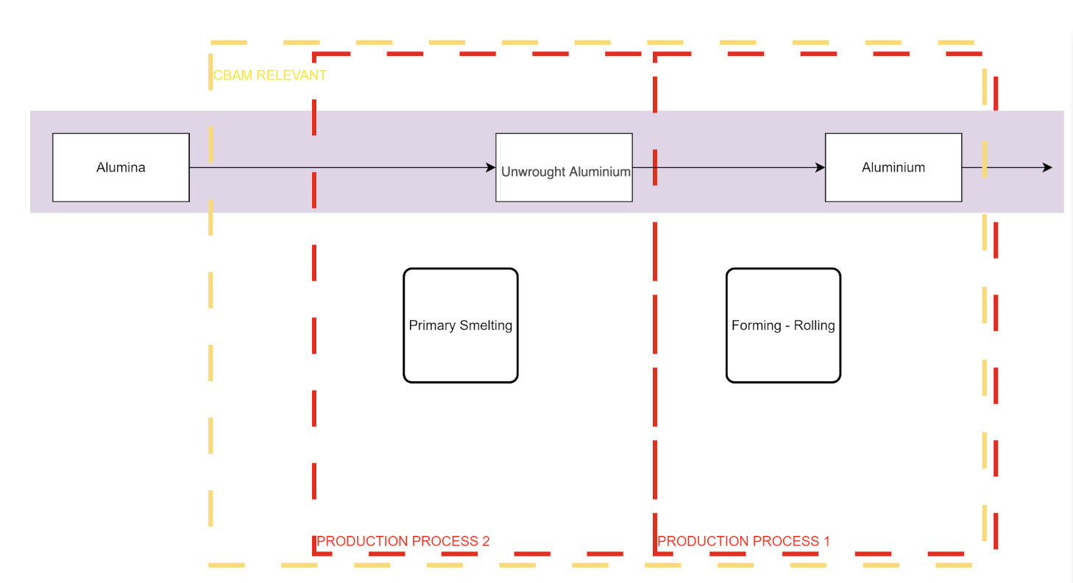
Step 1: System boundaries
Within the system boundaries are also the production processes used to transform raw materials into products.
Here, alumina is transformed into unwrought aluminum through primary smelting, and after some forming processes like rolling, we get aluminum.
In this example, the precursor of aluminum is unwrought aluminum. Additionally, alumina is the precursor of unwrought aluminum, but since it is outside the CBAM-relevant boundary, it will not be considered a precursor.
Notes:
Here Alumina is transformed into Unwrought Aluminum through primary smelting and after some forming processes like rolling we get the aluminium
For this example let's define that Process 1 is done by us as operators and process 2 is done by our supplier
There is a precursores missing:
the term "precursors" refers to materials, products, or substances that are used in the production of final goods covered by the CBAM regulation. These precursors are intermediate inputs that have significant carbon footprints and are critical in the manufacturing processes of products subject to the CBAM
EU taxonomy - look for definition of precursor
Unwrought aluminum is precorses of aluminum
The 2nd graph could be different

Slide 27
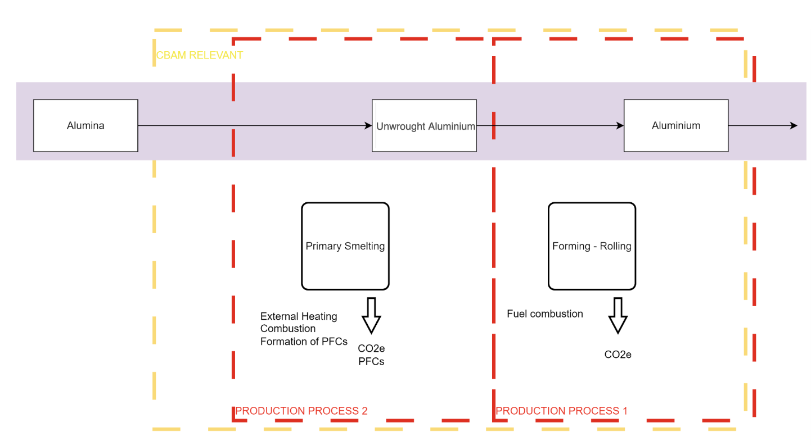
Step 1: System boundaries
The emissions we want to report on are from the production process of CBAM-relevant goods.
For example: to smelt the alumina, it needs to be heated, possibly by the combustion of a fuel. PFCs might also be released during this process.
These activities generate carbon dioxide or gases with global warming potential. You can find the conversion factors to CO2e here
*CO2e: Carbon dioxide equivalents (including CO2 and other gases with global warming potentials); **PFC: Perfluorocarbon

Slide 28
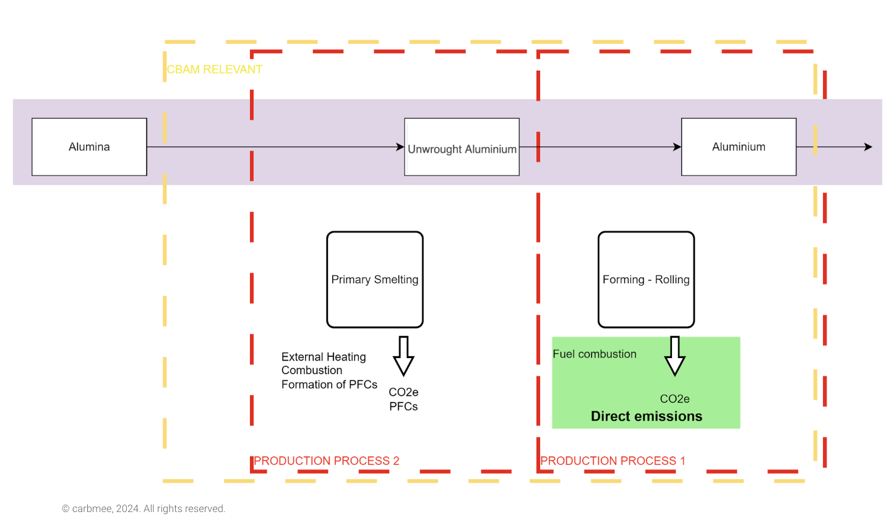
Step 1: System boundaries
The emissions generated by the combustion of fuel to heat the aluminum for rolling it are direct emissions.
*CO2e: Carbon dioxide equivalents (including CO2 and other gases with global warming potentials); **PFC: Perfluorocarbon
Notes:
WIP

Slide 29
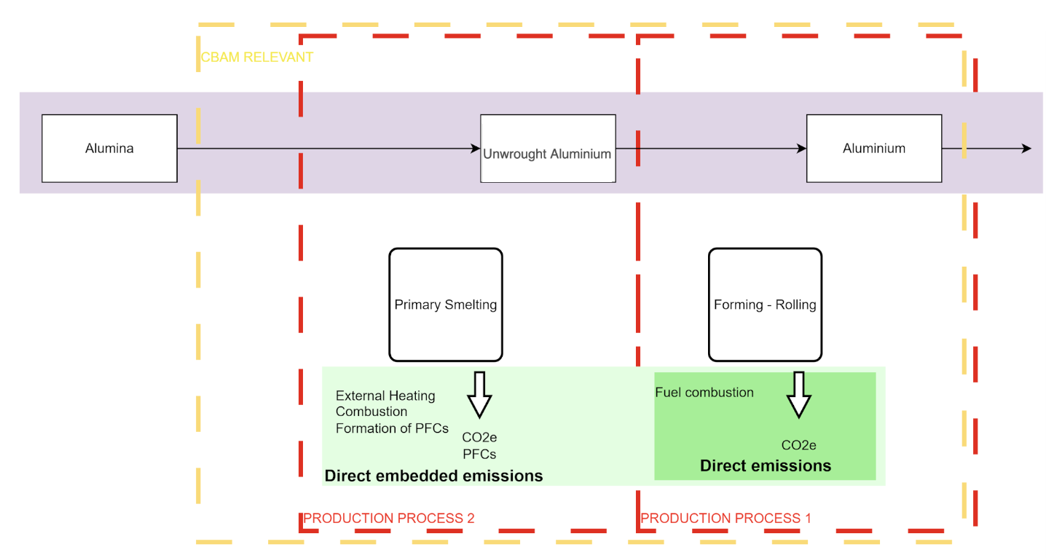
Step 1: System boundaries
When we look at all the emissions generated throughout the entire CBAM-affected process, we are referring to direct embedded emissions.
Direct embedded emissions include not only the emissions at your installation but also all the direct emissions of all the precursors used in the entire CBAM- relevant supply chain.
*CO2e: Carbon dioxide equivalents (including CO2 and other gases with global warming potentials); **PFC: Perfluorocarbon
Notes:
WIP

Slide 30
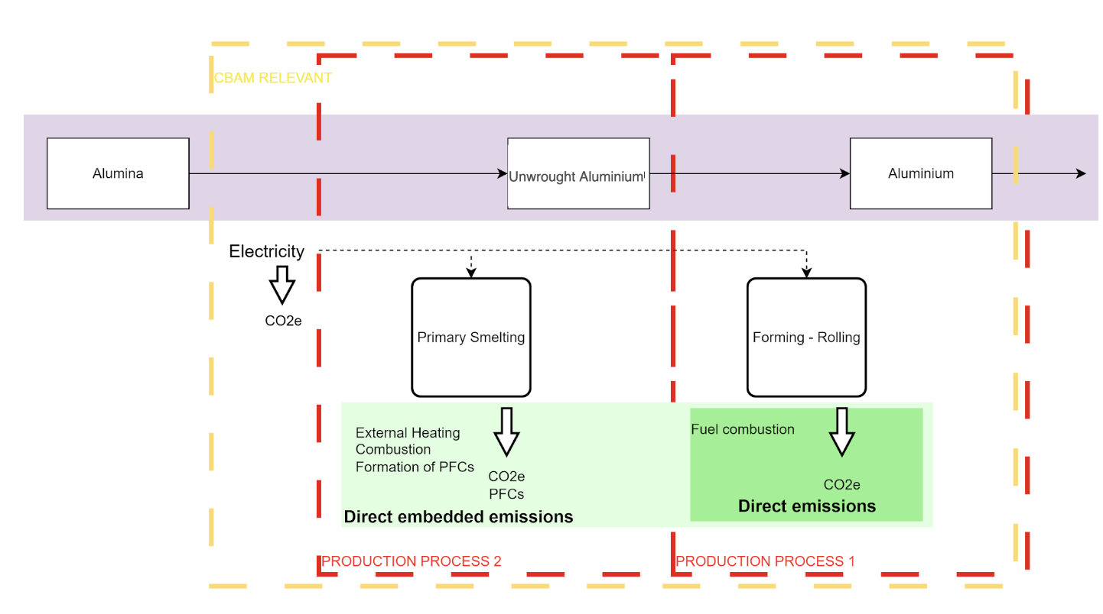
Step 1: System boundaries
Electricity is also used in the processes and part of the CBAM system boundaries.
If the electricity is purchased from a third party it needs to be reported separately.
*CO2e: Carbon dioxide equivalents (including CO2 and other gases with global warming potentials); **PFC: Perfluorocarbon
Notes:
WIP

Slide 31
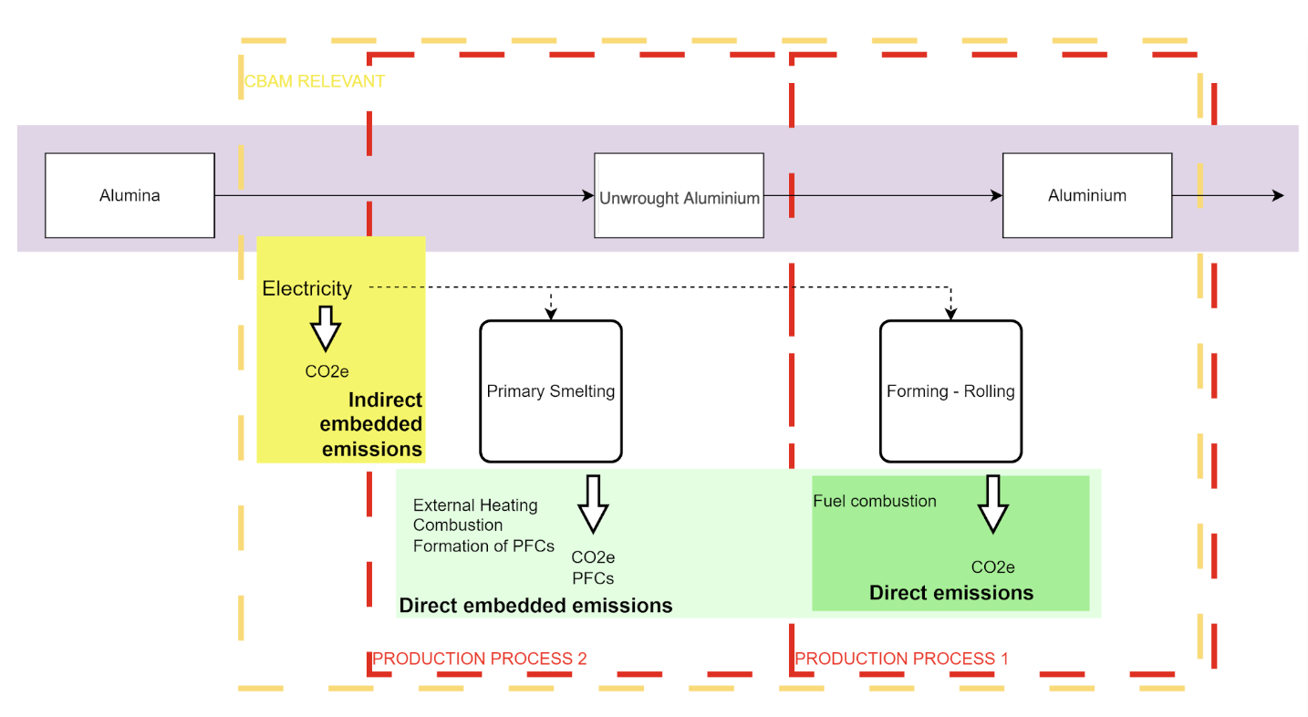
Step 1: System boundaries
The emissions linked to electricity production are called indirect emission.
In this diagram, we have electricity for both processes, the primary smelting (unwrought aluminium, production process 2) and forming -rolling (aluminium, production process 1). Both processes consume electricity and thus sum up to indirect embedded emissions.
*CO2e: Carbon dioxide equivalents (including CO2 and other gases with global warming potentials); **PFC: Perfluorocarbon
Notes:
WIP

Slide 32
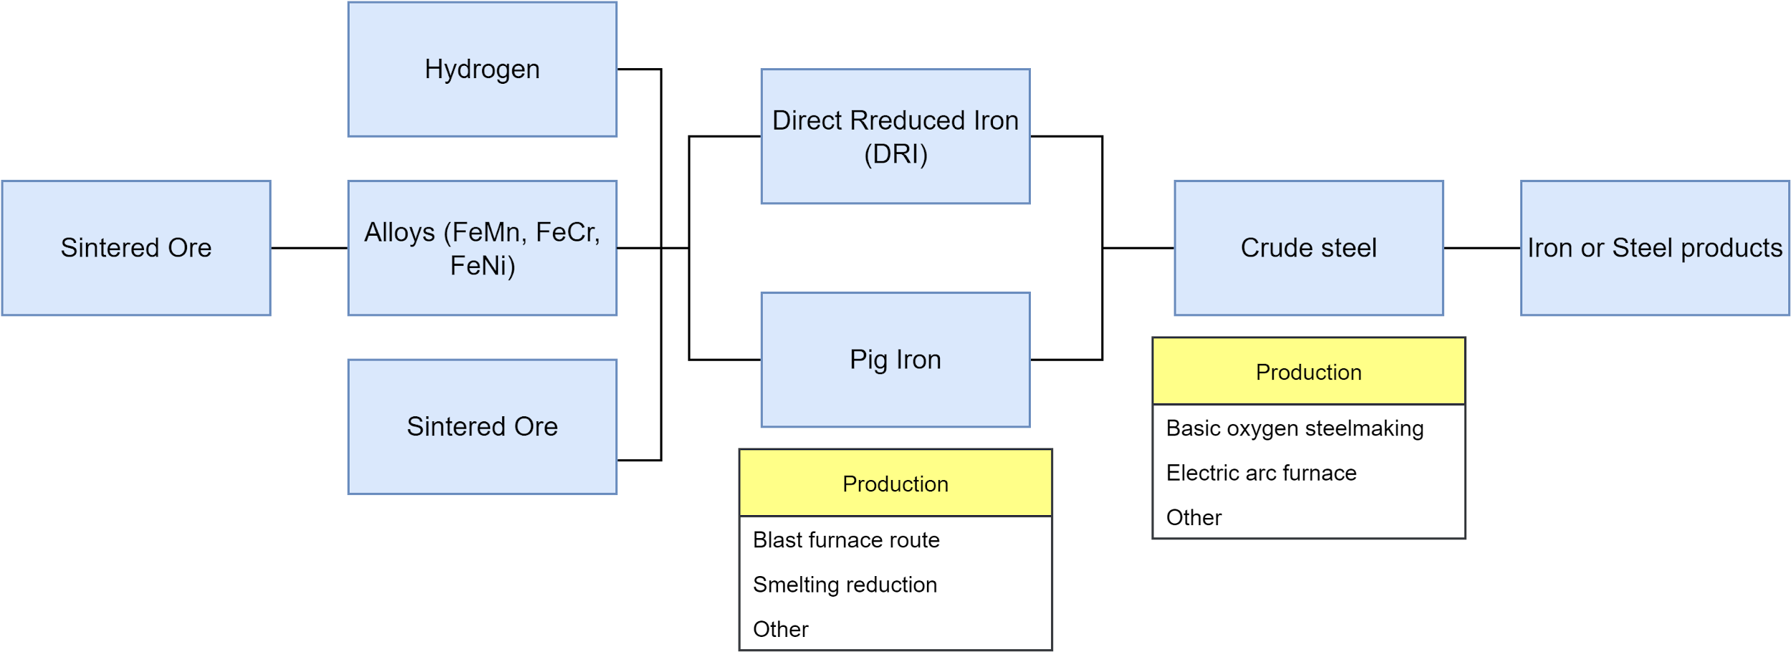
Step 1: System boundaries
Each material group affected by CBAM has a list of different precursors
that might be part of the production process
This is an example of the precursors and production steps for iron or steel products, which are commodities under CBAM regulations. When producing steel, the main precursor is always crude steel. Crude steel can be made using either DRI (Direct Reduced Iron) or pig iron. This tree-diagram reflects all possible production routes for iron/steel products.
For some precursors, production routes might need to be selected. For example, crude steel can be produced via basic oxygen steelmaking or using an electric arc furnace, among other methods.

Slide 33
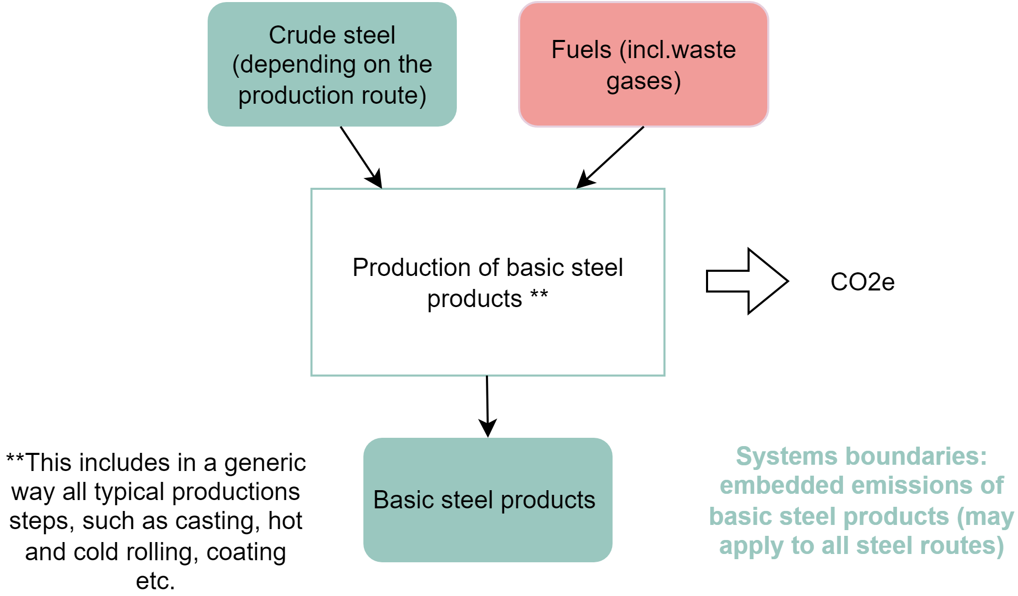
Iron or steel products production process
The production of basic steel products, as shown in the graph, uses crude steel and fuels as inputs. Only the crude steel is considered CBAM-relevant. During the transformation of crude steel, carbon dioxide is emitted, which needs to be accounted for. Some production steps that may be regarded as within the system boundaries of the production of basic steel products include:
RAW MATERIALS
FORMING PROCESSES
pre-heating, re-melting and alloying
including casting, hot and cold rolling, shaping by forging, wire drawing
FINISHING ACTIVITIES
EMISSIONS CONTROL
surface treatment, cutting, welding
or treating releases to air, water or ground
*CO2e: Carbon dioxide equivalents (including CO2 and other gases with global warming potentials)
Notes:
Modify graph!
Add explanation

Slide 34
Step 2: Choosing the best available data source
Accuracy: Select the data source with the lowest measurement error and highest precision.
Data Flow Integrity: Automated data sources that minimize human error and prevent data manipulation are preferable.
“Best”
Prioritize data sources already available within your operations, used for process control or cost calculation.
The legislation allows for the use of "second best" sources if the best options are impractical or too costly.
Its allowed to use measurements not under your control. E.g.: electricity meter
“Available”
Direct Determination: Preferred method, involving direct measurements like reading flow meters or weighing materials.
Indirect Determination: This involves estimation methods based on scientifically sound assumptions, such as calculating emissions from fuel consumption data.
“Data Source”

Slide 35
Step 3: Emissions
The emissions that need to be presented in CBAM should represent all of the following emission sources for each production route/process.
Direct Emissions
Indirect Emissions
HEAT
COMBUSTION
ELECTRICITY
Emissions from all heat used in the process
Fuel quantity
Electricity purchased for the processes
MJ
kg
kWh
If generated at the installation then account in direct
PROCESS EMISSIONS
PFCs
Emissions produced during production.
CO2 equivalent needs to be considered
Only for aluminium and only the gases CF4 and C2F6 need to be monitored
CO2e
CO2e
*CO2e: Carbon dioxide equivalents (including CO2 and other gases with global warming potentials)

Slide 36
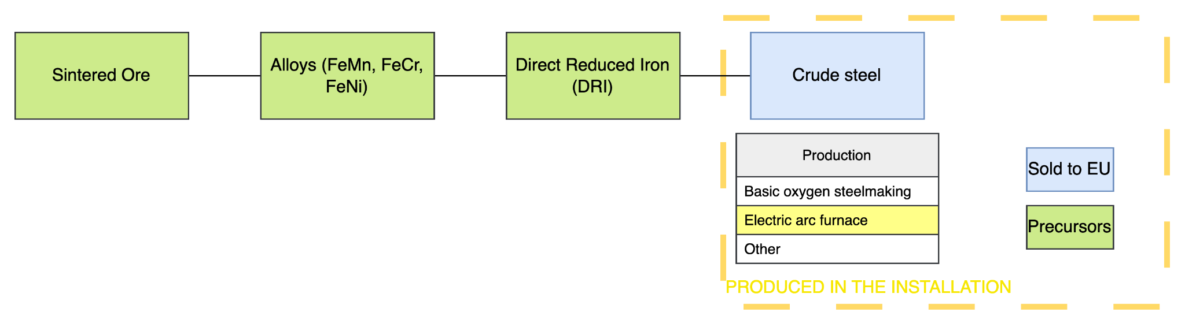
Step 4: Precursors
Precursors refer to materials or products that are intermediate goods used in the production of other goods that are subject to the CBAM
This installation produces crude steel that is sold into the EU. The production route used is electric arc furnace.
To comply with CBAM regulations, the installation needs to report not only the emissions generated by them but also the emissions of its precursors. In this case DRI, some alloys and sintered ore.

Slide 37
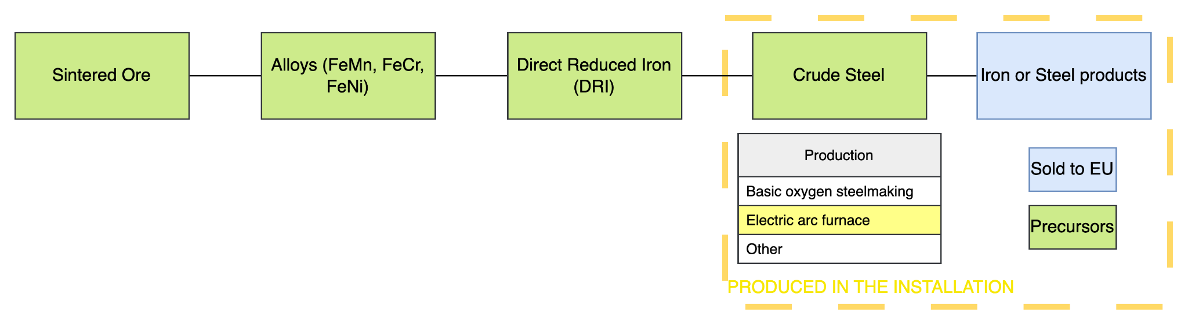
Step 4: Precursors
Precursors outside your installation require a collaboration with your suppliers, carbmee will support you in this process
The same installation also produces and sells iron products.
In this case, the precursors for these products will include crude steel as well as all the previously defined precursors.

Slide 38


Carbon Pricing
As shown in the graph companies outside the EU either fulfill the full scope of the EU-ETS pricing standards, or CBAM requires the importer to pay the difference between the local carbon price outside the EU and the EU-ETS carbon price
The actual price per tonne charged for the installation’s production processes and for the relevant precursors used in production should take into account:
  The actual price of a tonne CO2e in the carbon pricing scheme in the jurisdiction;
  The coverage of emissions of the production processes in the carbon pricing scheme (CBAM system boundaries)
Within the data collection CBAM requires to report on the carbon pricing effective in the country of origin of the goods. Information on the carbon price paid is obligatory from mid-2025. Carbmee EISTM enables & supports the data collection as of now. More details are shared in your 1:1 Supplier Training
Outside
EU
Fulfill EU-ETS
Standards?
No
Pay the difference to the EU ETS
Yes
Supplier
Inside
EU
Compliant carbon pricing
EU market
Total costs = produced & imported material (in t) * carbon price (in €)

Slide 39
Platform demo
© carbmee, 2024. All rights reserved.

Slide 40
Next steps
01
02
03
04
05
Attended a training webinar - part 1
Data Collection email and Attend 1:1 training - part 2
Access carbmee EISTM
Follow the tutorials
Add all the relevant data
Thank you for attending today’s training. You are a step closer to decarbonisation.
You will soon be invited and have the option to attend another training, that is a step by step guide.
You will be invited to create an account using the carbmee platform.
Use the guided tutorial to learn the basics of how to use the platform.
Add all the data, and feel free to contact us for any support. We are here for you!

Slide 41
Further information
For further information you can
Contact supplierengagement@carbmee.com for support
Visit the EU CBAM website
Access our Terminology document
Review the Annex
Discover the calculation Example
Download the CBAM document for operators
Regulation

Slide 42
Q&A
© carbmee, 2024. All rights reserved.

Slide 43

Thanks for
your attention
Carbmee Team
Please contact our Supplier Engagement Team on:
suppliersupport@carbmee.com
For more information about us: www.carbmee.com
©carbmee GmbH. All rights reserved. Proprietary and confidential.

Slide 44
Common terms
Emissions:
Refer to the release or discharge of substances into the environment, particularly the atmosphere. These substances can come from various sources and can be in different forms, such as gases, particulates, or radiation.
Material Number:
In the context of the EU Carbon Border Adjustment Mechanism (CBAM), a "material code" refers to a specific identifier used to classify goods and materials that are subject to the CBAM regulations. The CBAM aims to prevent carbon leakage by imposing a carbon price on imports of certain goods from countries with less stringent climate policies. Here’s a brief overview of what material codes signify in this mechanism:
CN Code:
In the context of the EU Carbon Border Adjustment Mechanism (CBAM), a "CN code" refers to a specific identifier used in the Combined Nomenclature (CN), which is the European Union’s system for classifying goods in trade

Slide 45
Common terms
EU Carbon Pricing:
Refers to the mechanisms implemented by the European Union to put a price on carbon emissions, aiming to reduce greenhouse gas (GHG) emissions and combat climate change. The primary tools for carbon pricing in the EU are the EU Emissions Trading System (EU ETS) and various national carbon taxes.
Systems boundaries:
System boundaries in reference to emissions define the scope and limits of what is included when calculating and reporting greenhouse gas (GHG) emissions. These boundaries determine which sources, activities, and processes are considered in the analysis, ensuring clarity, consistency, and comparability of emissions data. Setting system boundaries is crucial for accurate and meaningful emissions assessments.
Precursors:
In the context of the EU Carbon Border Adjustment Mechanism (CBAM), the term "precursors" refers to materials or products that are intermediate goods used in the production of other goods that are subject to the CBAM. These precursors are essential components or inputs in the manufacturing processes of products that have a significant carbon footprint.

Slide 46
Frequently Asked Questions (based on EU FAQ)
Why is the EU putting in place a Carbon Border Adjustment Mechanism?
• The EU is at the forefront of international efforts to fight climate change. The European Green Deal set out a clear path towards achieving the EU's ambitious target of a 55% net reduction in greenhouse gas emissions compared to 1990 levels by 2030, and to become climate-neutral by 2050. In July 2021, the Commission made its Fit for 55 policy proposals, since then, those policies have taken shape through negotiations with co-legislators, the European Parliament and the Council, and many have now been signed into EU law. This includes the EU’s Carbon Border Adjustment Mechanism (CBAM).
• As the EU raises its climate ambition and less stringent environmental and climate policies prevail in some non-EU countries, there is a strong risk of so-called ‘carbon leakage' – i.e.companies based in the EU could move carbon-intensive production abroad to take advantage of laxer standards, or EU products could be replaced by more carbon-intensive imports. Such carbon leakage can shift emissions outside of Europe and therefore seriously undermine the EU’s as well as global climate efforts. The CBAM will support the EU’s increased climate ambition and ensure that climate action is not undermined by production relocating to countries with less ambitious policies.

Slide 47
Frequently Asked Questions (based on EU FAQ)
2. What is the current stage of implementation of CBAM?
• The European Parliament and the Council of the European Union, as co-legislators, signed the CBAM Regulation (EU) 2023/956 on 10 May 2023.
CBAM entered into application in its transitional period on 1 October 2023, with the first quarterly reports due by 31 January 2024. The set of rules and requirements for the reporting of emissions under CBAM are further specified in Implementing Regulation (EU) 2023/1773 laying out reporting rules during the transitional period. The Commission has set up the transitional CBAM registry, is preparing further secondary legislation, and carrying out the planned analysis. The definitive period of CBAM will enter into force in January 2026.
• The European Commission has made available detailed guidance for the application of CBAM during the transitional period. These include detailed manuals, webinars, e-learnings, and other materials. All information supporting the implementation can be accessed on the Commission’s CBAM webpage (here).

Slide 48
Frequently Asked Questions (based on EU FAQ)
3. Is it mandatory to use the communication template Excel file?
• No, the use of the communication template is not compulsory but recommended.
• The communication template is a tool that allows operators to determine the embedded emissions in CBAM goods according to the methodology specified in Implementing Regulation (EU) 2023/1773. The template ensures that all relevant source streams and emission sources, electricity consumption as well as relevant precursors are taken into account for the calculation.
• The template contains a worksheet ‘Summary_Communication’ that contains all information needed by the reporting declarant. This worksheet thus facilitates the communication between third-country producers and importers (or their
representatives).

Slide 49
BACKUP

